Slide 1

CSE-4078 Mobile Application Development
Lecture 8 and 9
Sara Masood

Slide 2
Outline
Stateful Widgets
Buttons
Button Pressed
Using Git with Android Studio
Dart crash course

Slide 3
packages
Flutter supports using shared packages contributed by other developers to the Flutter and Dart ecosystems
Packages
At a minimum, a Dart package is a directory containing a pubspec file. Additionally, a package can contain dependencies (listed in the pubspec), Dart libraries, apps, resources, tests, images, and examples
Plugins
A plugin package is a special kind of package that makes platform functionality available to the app.
For example, a plugin might provide Flutter apps with the ability to use a device’s camera.
Using packages | Flutter

Slide 4
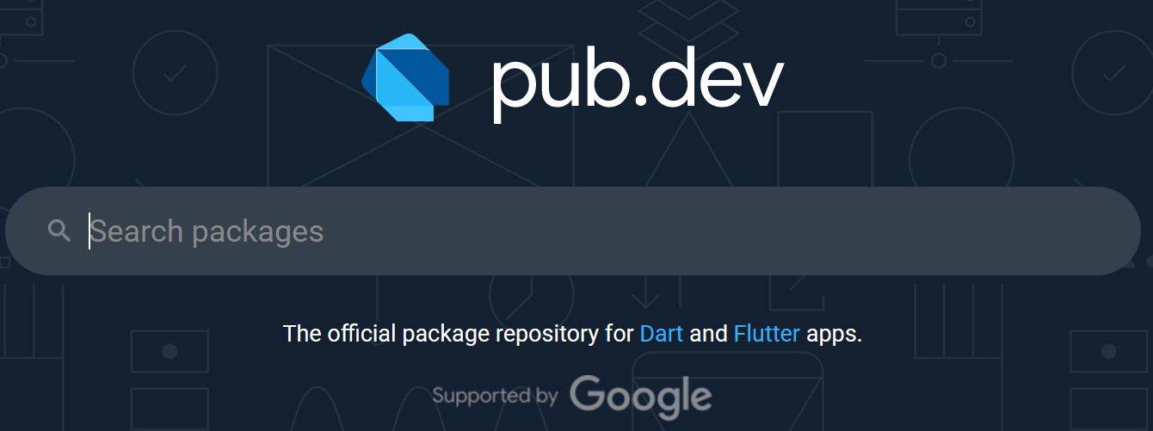
Using packages
Searching for packages
Packages are published to pub.dev.
Dart packages (pub.dev)
Contain likes, PUB points, and Popularity

Slide 5
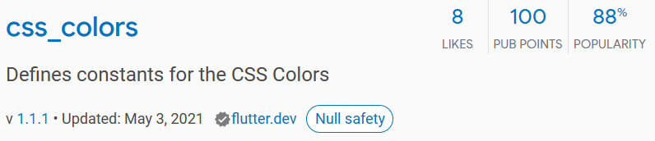
Using packages
Depend on it
Install it
Import it
Stop and restart the app, if necessary

Slide 6
Adding dependencies
In pubspec.yaml file.
dependencies:
css_colors: ^1.0.0 # Good, any version >= 1.0.0 but < 2.0.0
url_launcher: ^5.4.0
image_picker: '5.4.3' # Not so good, only version 5.4.3 works.

Slide 7
Installing packages
Run the command flutter pub get
OR
From Android Studio/IntelliJ: Click Packages get in the action ribbon at the top of pubspec.yaml.
From VS Code: Click Get Packages located in right side of the action ribbon at the top of pubspec.yaml.

Slide 8
Import packages
Add the import statements
import 'package:css_colors/css_colors.dart’;
import 'package:url_launcher/url_launcher.dart';

Slide 9
Using the url_launcher package to launch the browser
class DemoPage extends StatelessWidget {
launchURL() {
launch('https://flutter.dev');}
@override
Widget build(BuildContext context) {
return Scaffold(
body: Center(
child: ElevatedButton(
onPressed: launchURL,
child: Text('Show Flutter homepage'),),),);}}

Slide 10
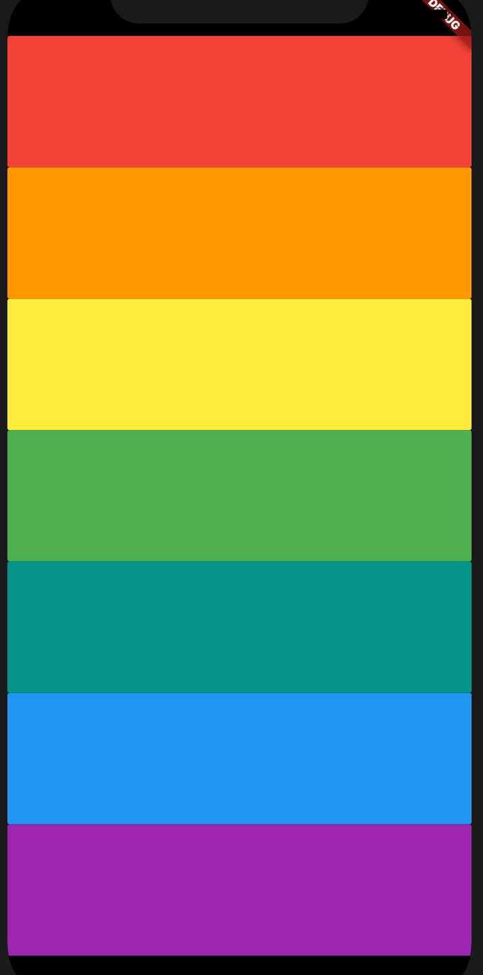
Working Example – Xylophone app
We’re going to make a music app that plays Xylophone sounds.
For every Beethoven out there, this will let you unleash your musical talent where ever you are.

Slide 11
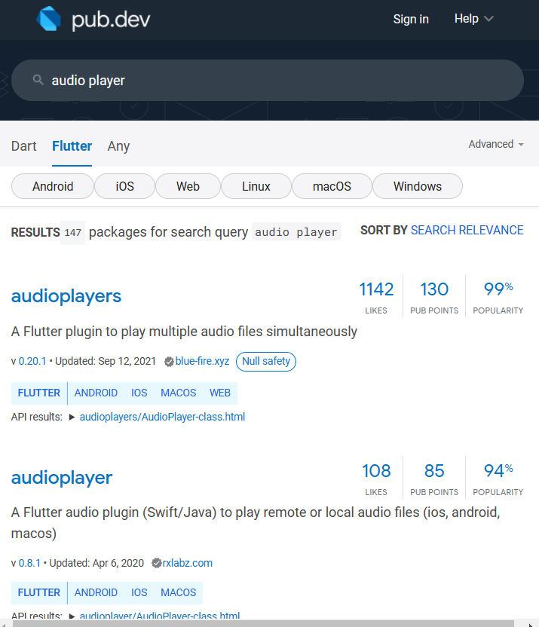
Search for packages
Dive into the Likes, PUB Points, popularity, and developer to decide the package.

Slide 12
Add dependency and import
dependencies:
audioplayers: ^0.20.1
import 'package:audioplayers/audioplayers.dart’;
import 'package:audioplayers/audio_cache.dart';

Slide 13
Create player object and play files
final player = AudioCache();
player.play(‘audio.wav');

